Slide 1
By Santhosh
SAP Commerce Demo Session

Slide 2
Contents
Introduction
Product Line
Support & Release Strategy
Architecture Overview
Online Resources
Spring Overview

Slide 3
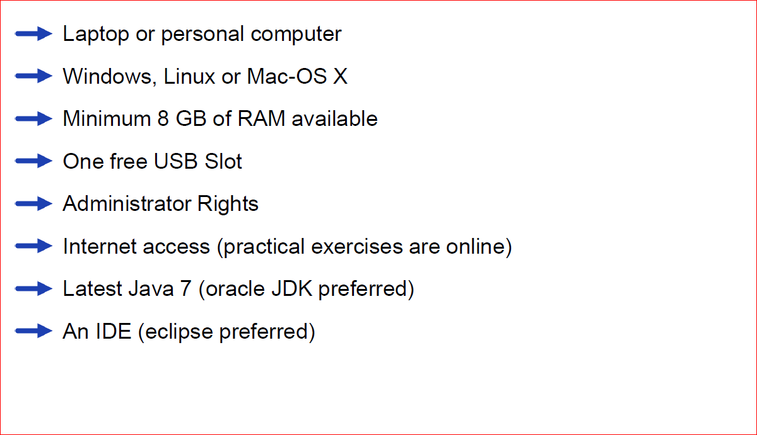
Hardware requirements

Slide 4
Contents
Introduction
Product Line
Support & Release Strategy
Architecture Overview
Online Resources
Spring Overview

Slide 5
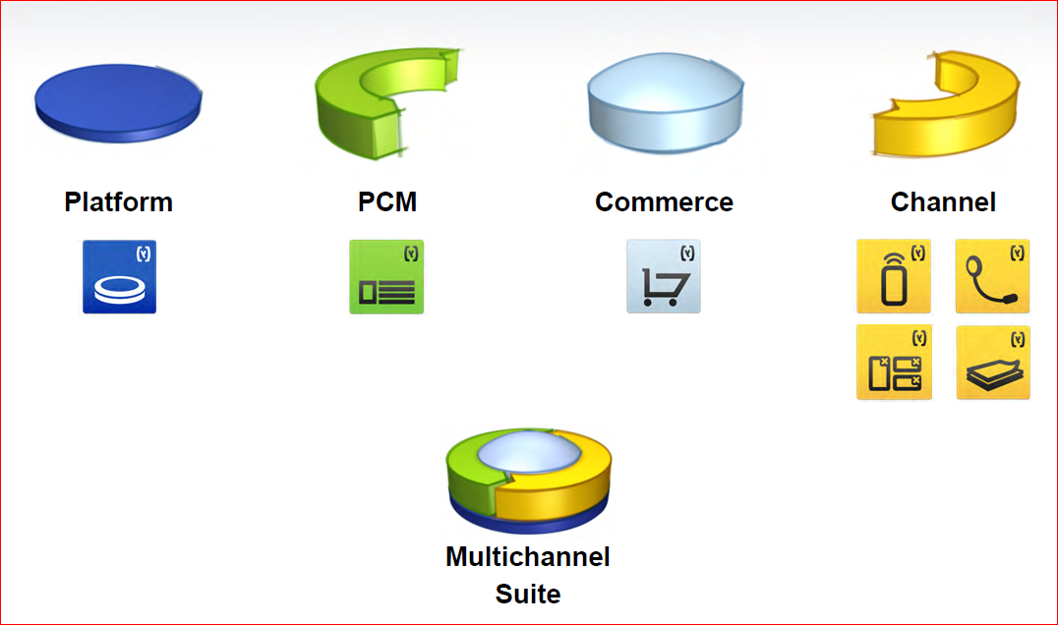
The industry’s most modern, agile, comprehensive commerce suite

Slide 6
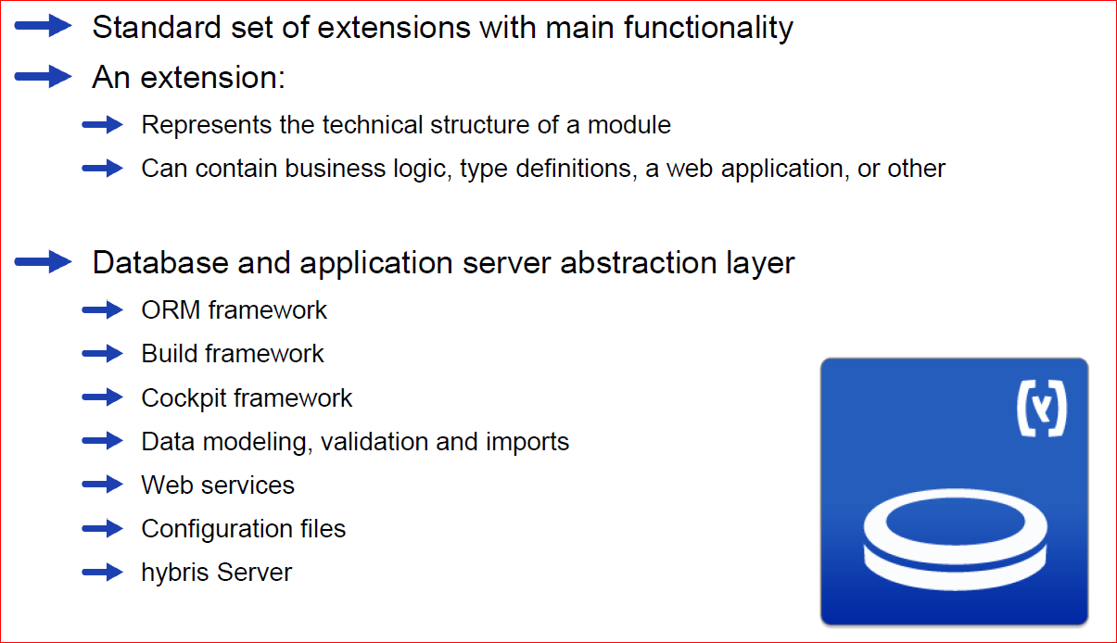
hybris Platform

Slide 7
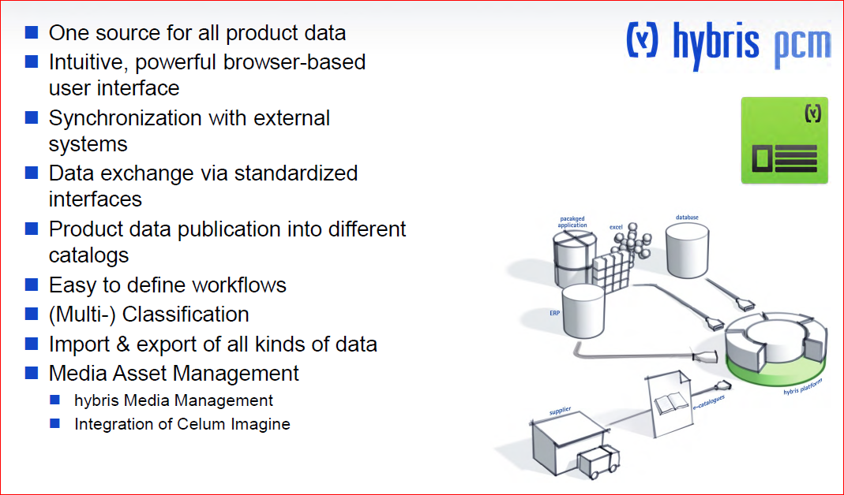
hybris PCM

Slide 8
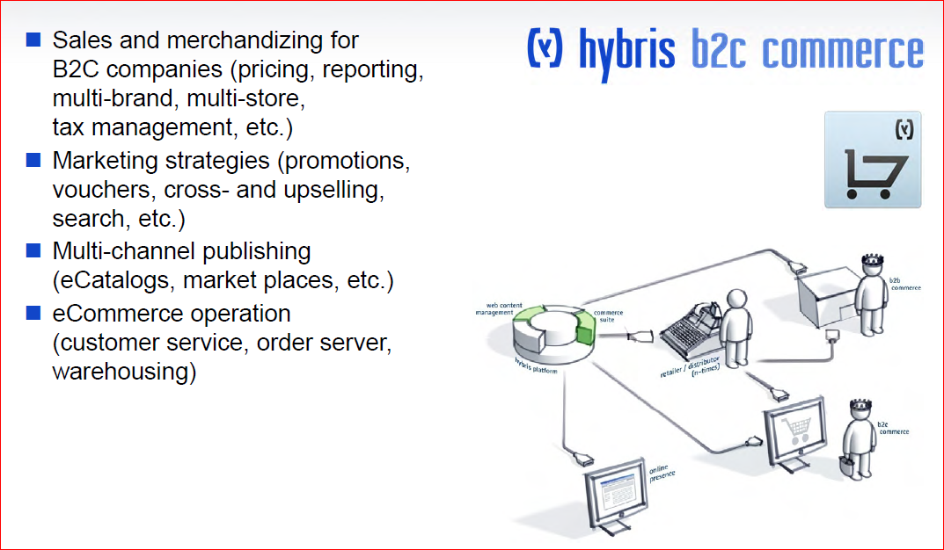
hybris B2C Commerce

Slide 9
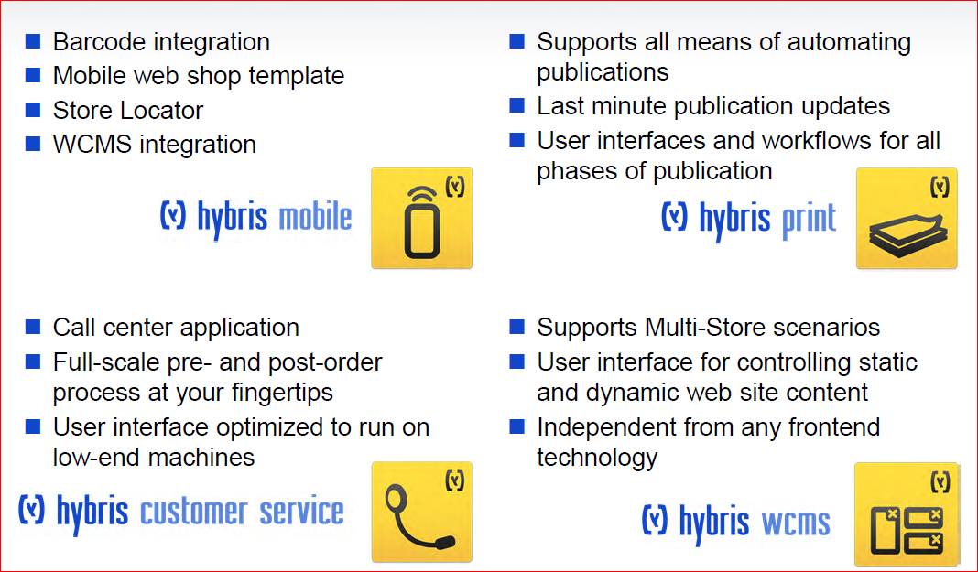
hybris Channel

Slide 10
Contents
Introduction
Product Line
Support & Release Strategy
Architecture Overview
Online Resources
Spring Overview

Slide 11
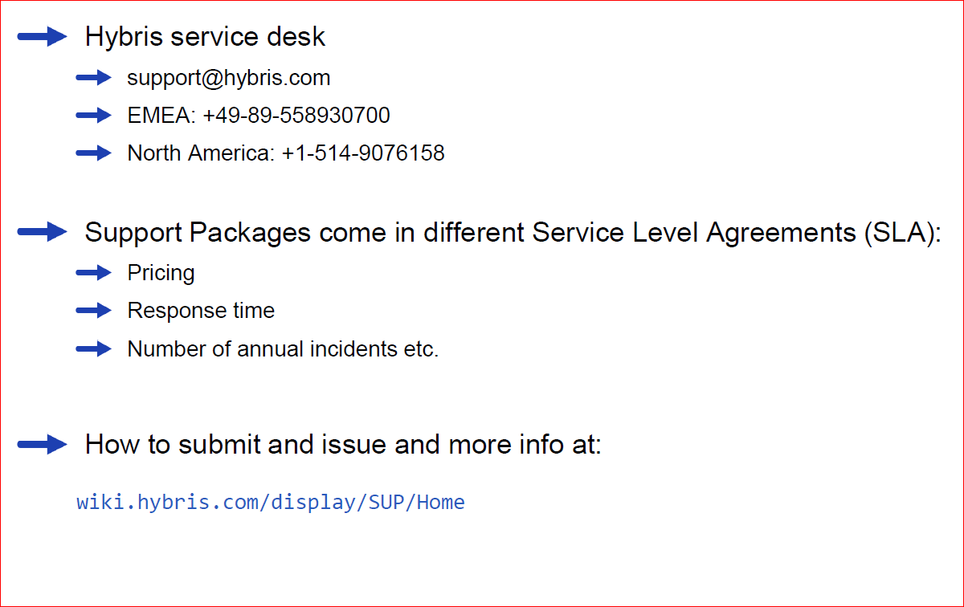
Support Packages

Slide 12
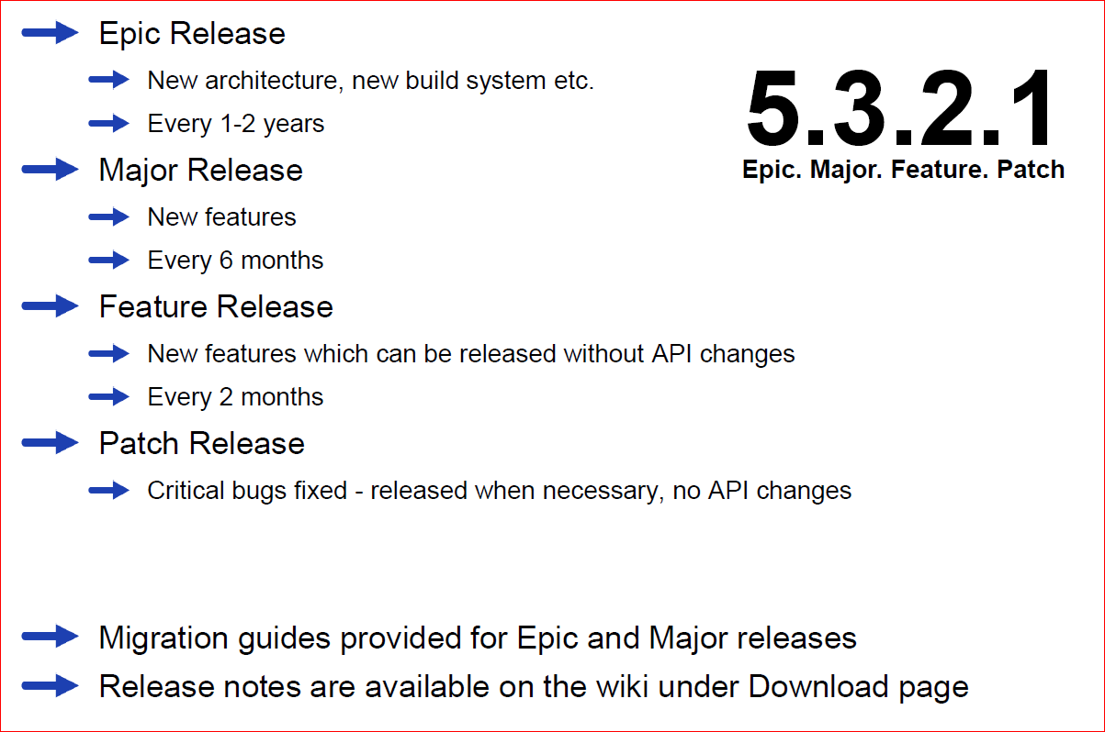
Releases

Slide 13
Contents
Introduction
Product Line
Support & Release Strategy
Architecture Overview
Online Resources
Spring Overview

Slide 14
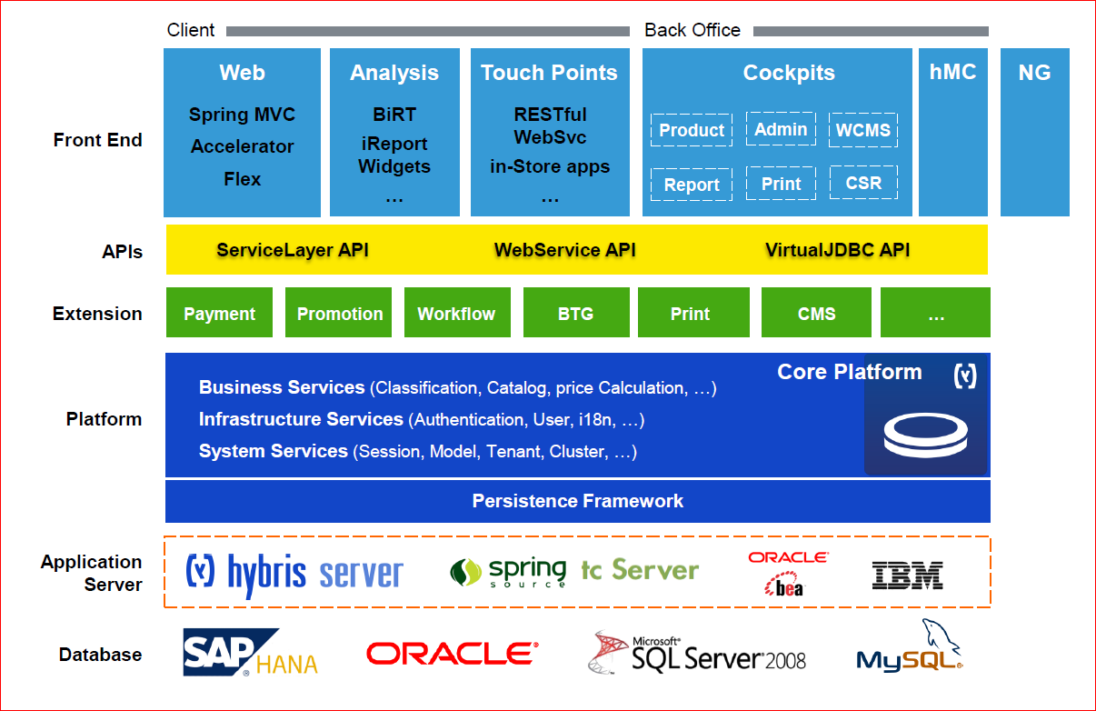
Architecture Overview

Slide 15
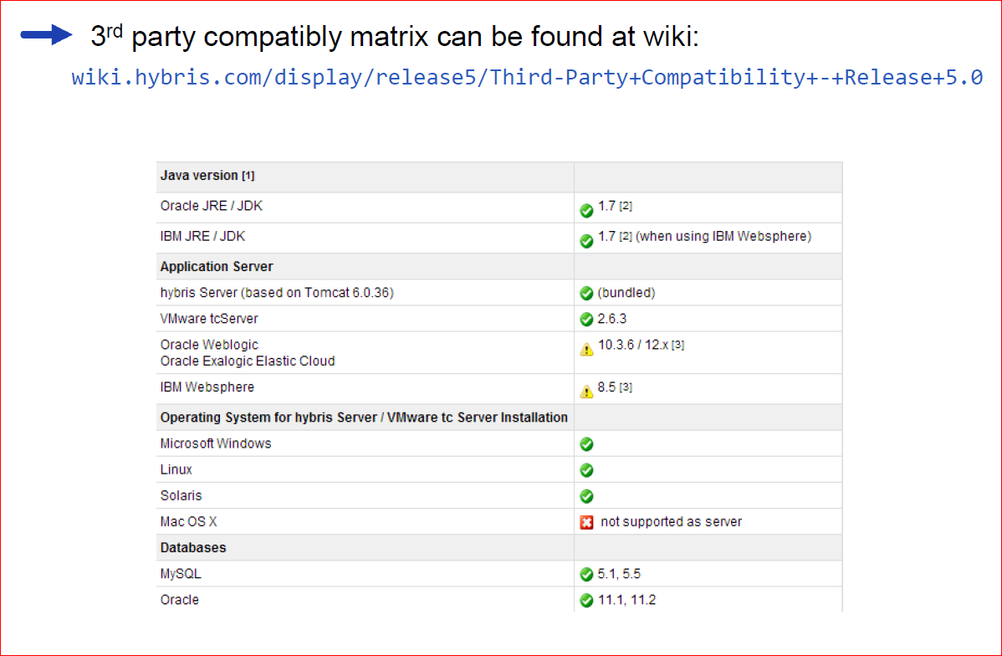
3rd party compatibility

Slide 16
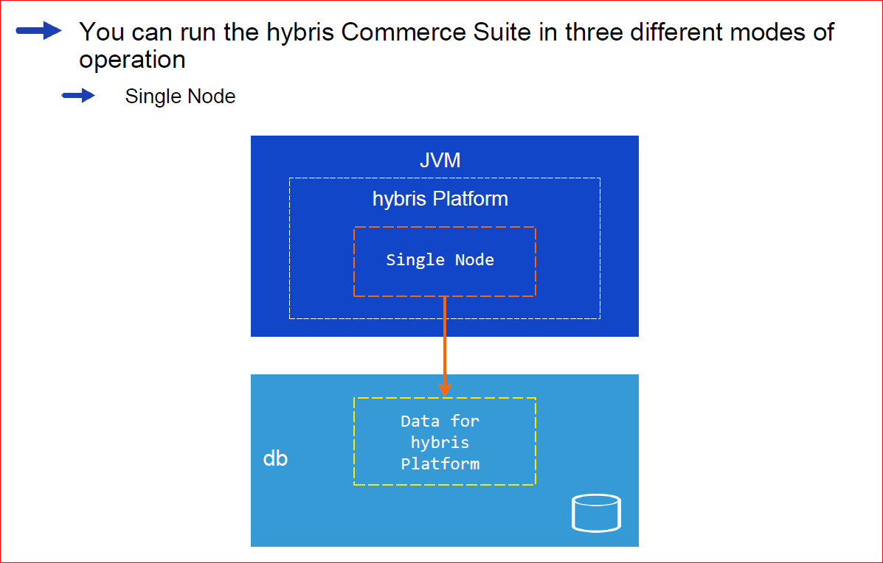
Modes of operation

Slide 17
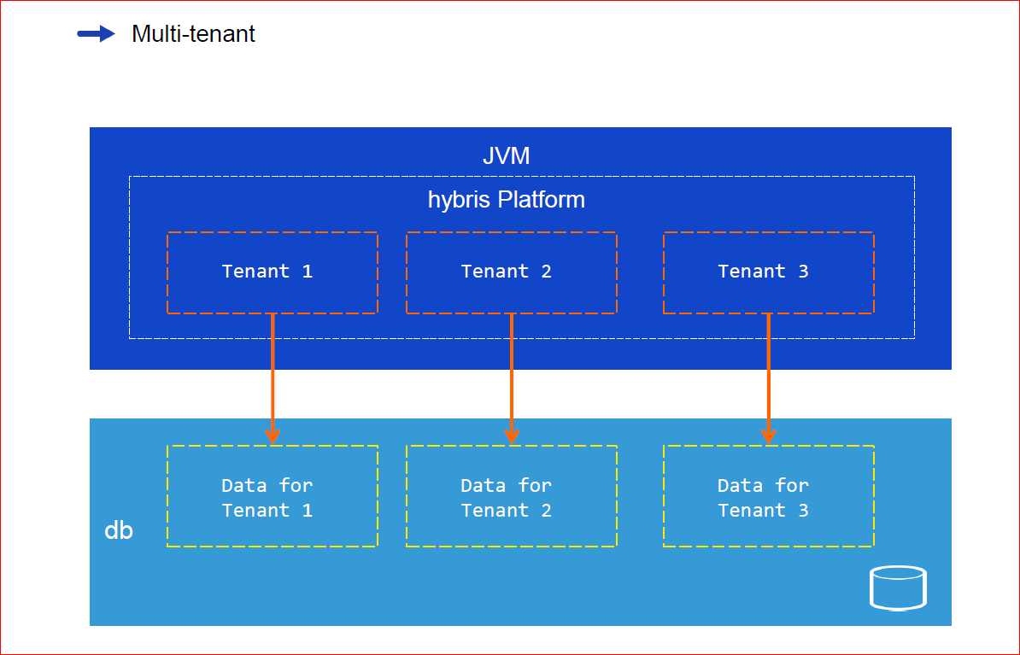
Modes of operation

Slide 18
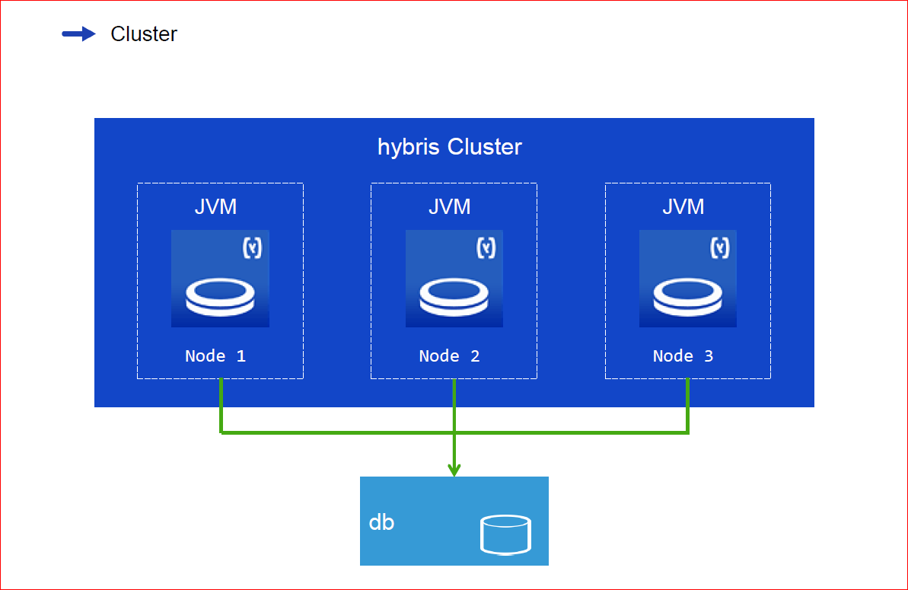
Modes of operation

Slide 19
Multi-Tenant System in Hybris e-commerce suite & Difference between Multi-Tenant and cluster mode
Multi-Tenants means individual set of data across one database .Hybris e-commerce suite provide to run one single codebase over multiple set of data . Following below point need to remember related to hybris point of view: 1. It provides isolation between set of data (tenant). 2. It provides individual time zone and locale setting.
Hybris multi-Tenant completely differs from Hybris clustering as below A hybris Cluster is a concept different from multi-tenant hybris Commerce Suites. A hybris Cluster is a number of individual, separate hybris Commerce Suites sharing one single set of data, whereas a multi-tenant hybris Commerce Suite is one single hybris Commerce Suite using individual sets of data.

Slide 20
Contents
Introduction
Product Line
Support & Release Strategy
Architecture Overview
Online Resources
Spring Overview

Slide 21
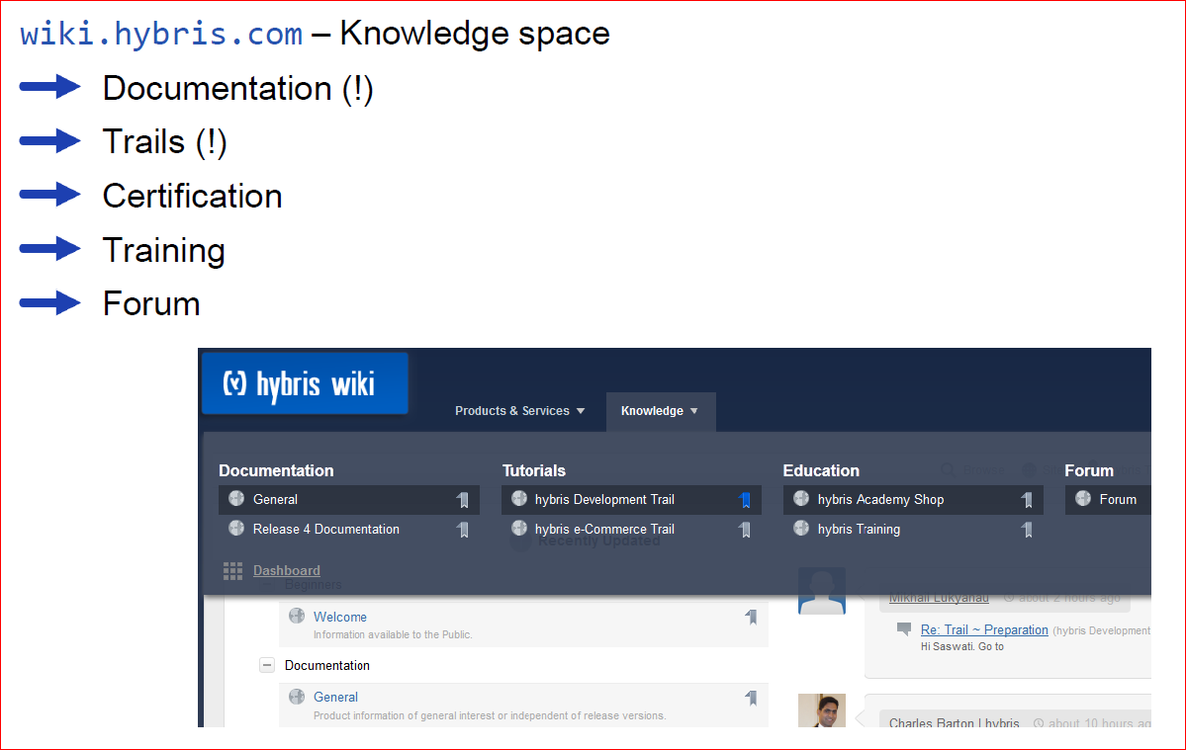
hybris Wiki – Knowledge

Slide 22
Contents
Introduction
Product Line
Support & Release Strategy
Architecture Overview
Online Resources
Spring Overview

Slide 23
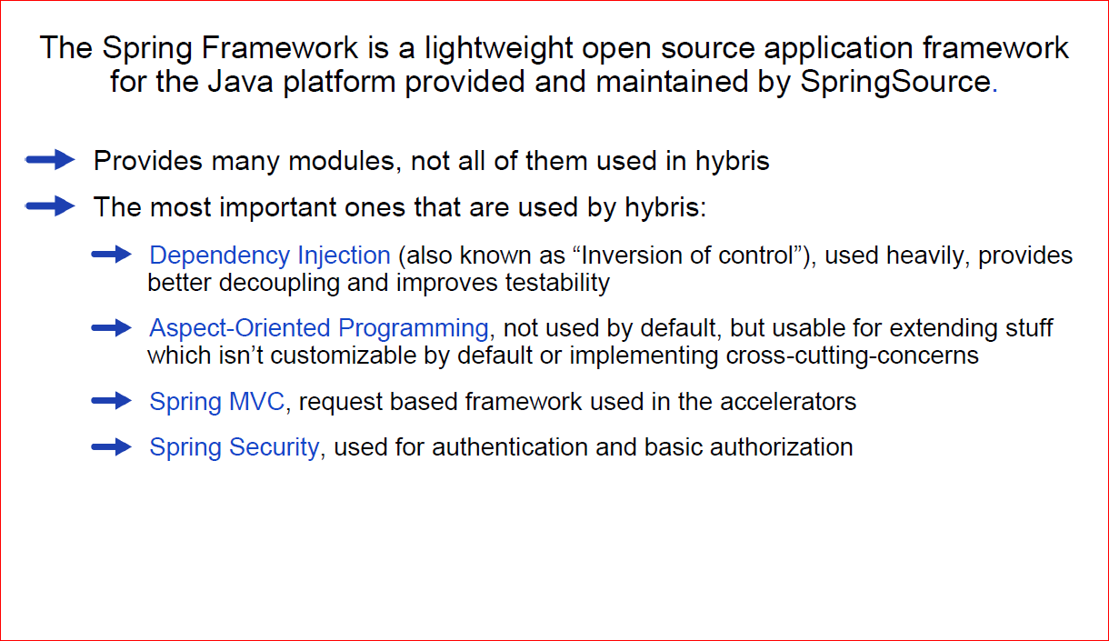
What is Spring?

